Slide 1
MY SELF
COURSE: MERN STACK DEVELOPER
I’m Mahendra Singh
I’m from udaipur ( Rajasthan)

Slide 2
I AM…...
HONEST…
DISCIPLINED…
RESPECTFUL…
STRONG…
HELPING NATURE

Slide 3
SWOT
STRENGTH
Hardwarking
Teamwork
Self Motivated.
WEAKNESS
Overthinking
Time Management
Getting more angry
Public speaking
THEREATS
Economic conditions effecthin jobs.
Competition
OPPURTUNITIES
Get help on projects.
Propese working groups.
Creat a team work on an idea my have

Slide 4
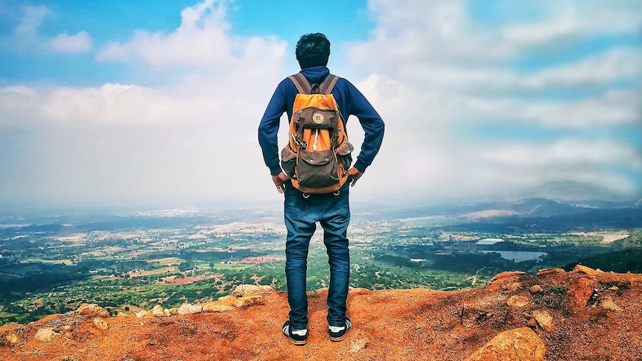
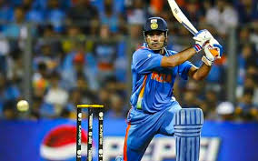
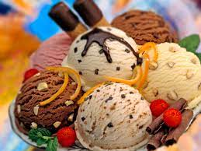
I LOVE….
TREAVELING…
MANGO…
PLAYING CRICKET…
SPENDING TIME WITH FRIENDS…
ICE CREAM…
COOL DRINKS…

Slide 5
I HATE…
FIGHTING…
BACK BITING…
SMOKING….
CEAT…

Slide 6
“What you do to others, will happen to you. do not do bad deeds.”
THANK YOU SOO MUCH

